Slide 1
Programming Or Implementation Phase
By: Nida Munawar

Slide 2
Programming Or Implementation Phase
Transcribing the logical flow of solution steps in flowchart or algorithm to program code and run the program code on a computer using a programming language.
Programming phase takes 5 stages:
Coding.
Compiling.
Debugging.
Run or Testing.
Documentation and maintenance.

Slide 3
Programming Or Implementation Phase
Once the program is coded using one of the programming language, it will be compiled to ensure there is no syntax error. Syntax free program will then be executed to produce output and subsequently maintained and documented for later reference.

Slide 4
CODING
COMPILE THE
PROGRAM
MAKE
CORRECTION
NO SYNTAX
ERROR
EXECUTE OR
RUN
DOCUMENTATION OR MAINTENANCE

Slide 5
Problem 1
Write a Problem Analysis Chart (PAC) to convert
the distance in miles to kilometers where 1.609
kilometers per mile.

Slide 6
start
read miles
km = 1.609 x miles
print km
end

Slide 7
Problem 2
Write a Problem Analysis Chart (PAC) to find an area of a circle where area = pi * radius * radius

Slide 8
start
read radius
area = 3.14 x radius x radius
print area
end

Slide 9
Programming Or Implementation Phase
Coding
Translation or conversion of each operation in the flowchart or algorithm (pseudocode) into a computer-understandable language.
Coding should follow the format of the chosen programming language.
A programming language is a formal language designed to communicate instructions to a computer. There are two major types of programming languages: low-level languages and high-level languages.
Many types or levels of computer programming language such as:
Machine language
Symbolic language or assembly language
Procedure-oriented language
The first two languages are also called low-level programming language. While the last one is called high-level programming language.

Slide 10
Programming Or Implementation Phase
Machine Language
Machine language uses number to represent letters, alphabets or special character that are used to represent bit pattern.
Example:
an instruction to add regular pay to overtime pay, yielding total pay might be written in machine language as follows:
16 128 64 8
in which 16 is a code that mean ADD to the computer. The 128 and 64 are addresses or location at which regular pay and overtime pay are stored. The 8 represents the storage location for the total pay.

Slide 11
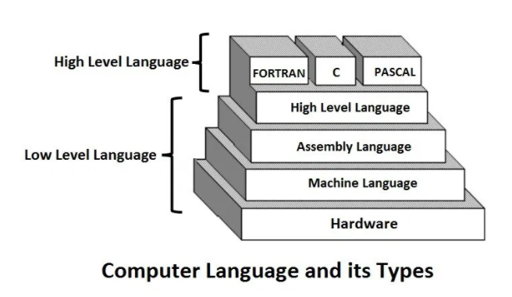

Slide 12
Programming Or Implementation Phase
Sometimes, bit pattern that represent letters and alphabets are used for coding.
Example:
Instead of: 16 128 64 8
Use: 10000 10000000 1000000 1000
This representation is ideal for a computer but difficult and tedious to the programmer to write a lengthy program.

Slide 13
Programming Or Implementation Phase
Symbolic Language or Assembly Language
A symbolic language or assembly language is closely related to machine language in that, one symbolic instruction will translate into one machine-language instruction.
Contain fewer symbols, and these symbols may be letters and special characters, as well as numbers.
As example, a machine language instruction
16 128 64 8
can be rewritten in assembly language as
ADD LOC1 LOC2 LOC3
Which means, add content of location LOC1 to location LOC2 and put the result in location LOC3.

Slide 14
Programming Or Implementation Phase
Procedure – Oriented Language
Programmer has to know the computer hardware before he can write program in machine and assembly language. It means the language is machine dependent.
Using procedure – oriented language, the programmer can run the program in any computer hardware.
A special program called a compiler will translate program written using procedure – oriented language to machine language.

Slide 15
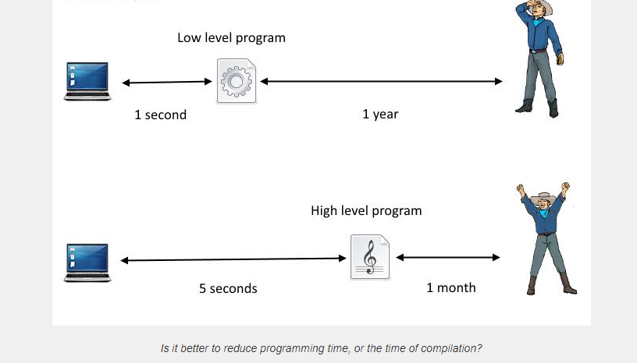

Slide 16
Programming Or Implementation Phase
Some example of the language:
COBOL (COmmon Business Oriented Language)
FORTRAN (FORmula TRANslation)
Pascal
C
C++
BASIC, etc.
These languages are also called high-level programming language

Slide 17
Programming Or Implementation Phase
Computer Language | Instruction Format
Machine language Assembly language BASIC FORTRAN COBOL Pascal C | 16 128 64 8 ADD LOC1 LOC2 LOC3 LET T = R + 0 TOTAL = RPAY + OPAY ADD RPAY, OPAY GIVING TOTAL TOTAL : = RPAY + OPAY TOTAL = RPAY + OPAY

Slide 18
Programming Or Implementation Phase
Compiling and Debugging
Compiling is a process of a compiler translates a program written in a particular high–level programming language into a form that the computer can execute.
The compiler will check the program code known also as source code so that any part of the source code that does not follow the format or any other language requirements will be flagged as syntax error.
This syntax error in also called bug, when error is found the programmer will debug or correct the error and then recompile the source code again.
The debugging process is continued until there is no more error in the program.

Slide 19
Programming Or Implementation Phase
Testing
The program code that contains no more error is called executable program. It is ready to be tested.
When it is tested, the data is given and the result is verified so that it should produced output as intended.
Though the program is error free, sometimes it does not produced the right result. In this case the program faces logic error.
Incorrect sequence of instruction is an example that causes logic error.

Slide 20
Programming Or Implementation Phase
Documentation and Maintenance
When the program is thoroughly tested for a substantial period of time and it is consistently producing the right output, it can be documented.
Documentation is important for future reference. Other programmer may take over the operation of the program and the best way to understand a program is by studying the documentation.
Trying to understand the logic of the program by looking at the source code is not a good approach.
Studying the documentation is necessary when the program is subjected to enhancement or modification.
Documentation is also necessary for management use as well as audit purposes.

